Slide 1

Guidelines for 2021
Undergraduate Admission

Slide 2
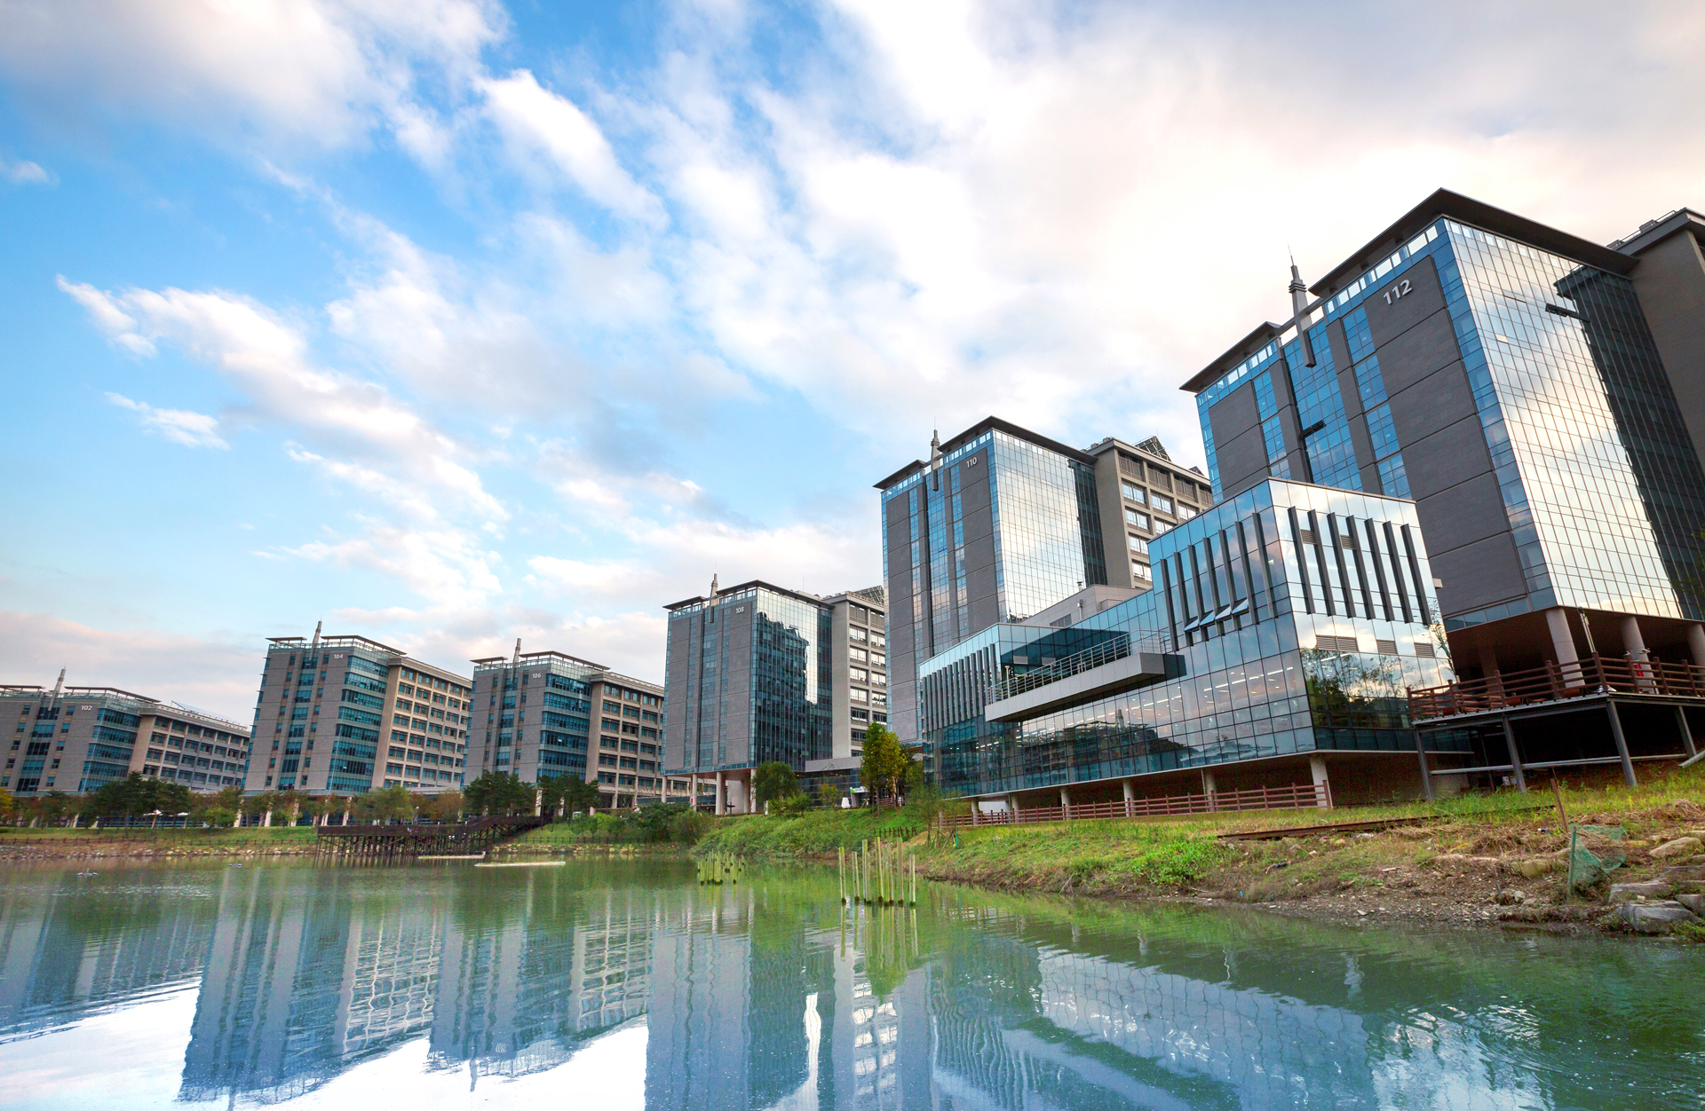
Brief History
APR. 2020
Selected to run Government-funded
AI Graduate School
May. 2017
Established Three Major Institutes in Germany
Hans Scholer Stem Cell Research Center(Aug, 2010)
Fraunhofer Project Center(Dec, 2016)
Helmholtz Jueiich Future Energy Innovation Research
Center(May, 2017)
Mar, 2015
Approval of the Law for the status change of UNIST
Aug, 2014
Genomic Integrity Launched IBS(Institute for Basic Science)
Campus Research Center
Jan, 2014
Soft and Living Matter
Nov, 2013
Multidimensional Carbon Materials
Jul, 2011
Selected as on of Four research-oriented universities for special support by
the Ministry of Education, Science and Technology
Mar, 2009
Held the 1st Entrance ceremony

Slide 3
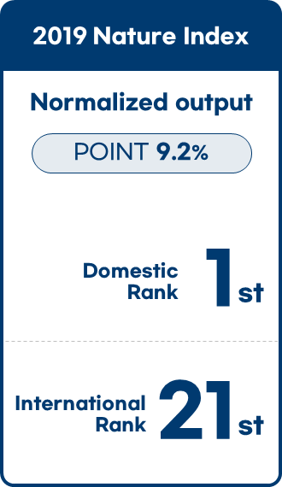
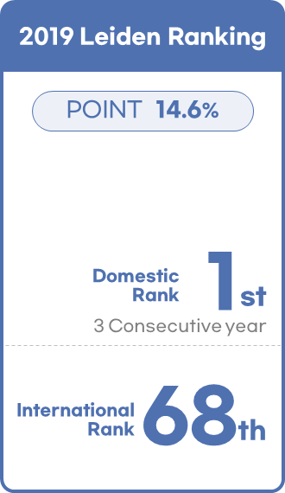
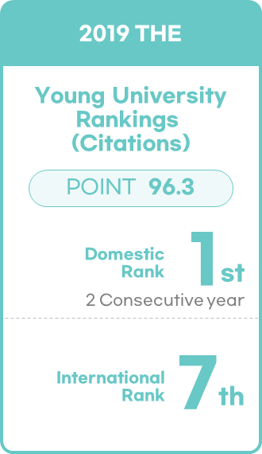
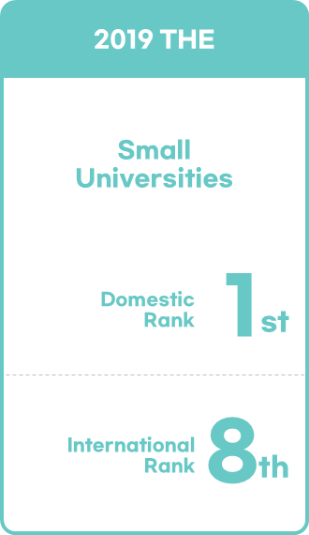
University Ranking
Small Universities:
Universities that have fewer than 5000 undergraduate and graduate students.
2019 Nature Index
2019 Leiden Ranking
2019 THE
2019 THE
Normalized output
POINT 14.6%
Young University
Rankings
(Citations)
POINT 9.2%
Small
Universities
POINT 96.3
1st
1st
1st
1st
Domestic
Rank
Domestic
Rank
Domestic
Rank
Domestic
Rank
3 Consecutive year
2 Consecutive year
21st
68th
7th
8th
International
Rank
International
Rank
International
Rank
International
Rank

Slide 4
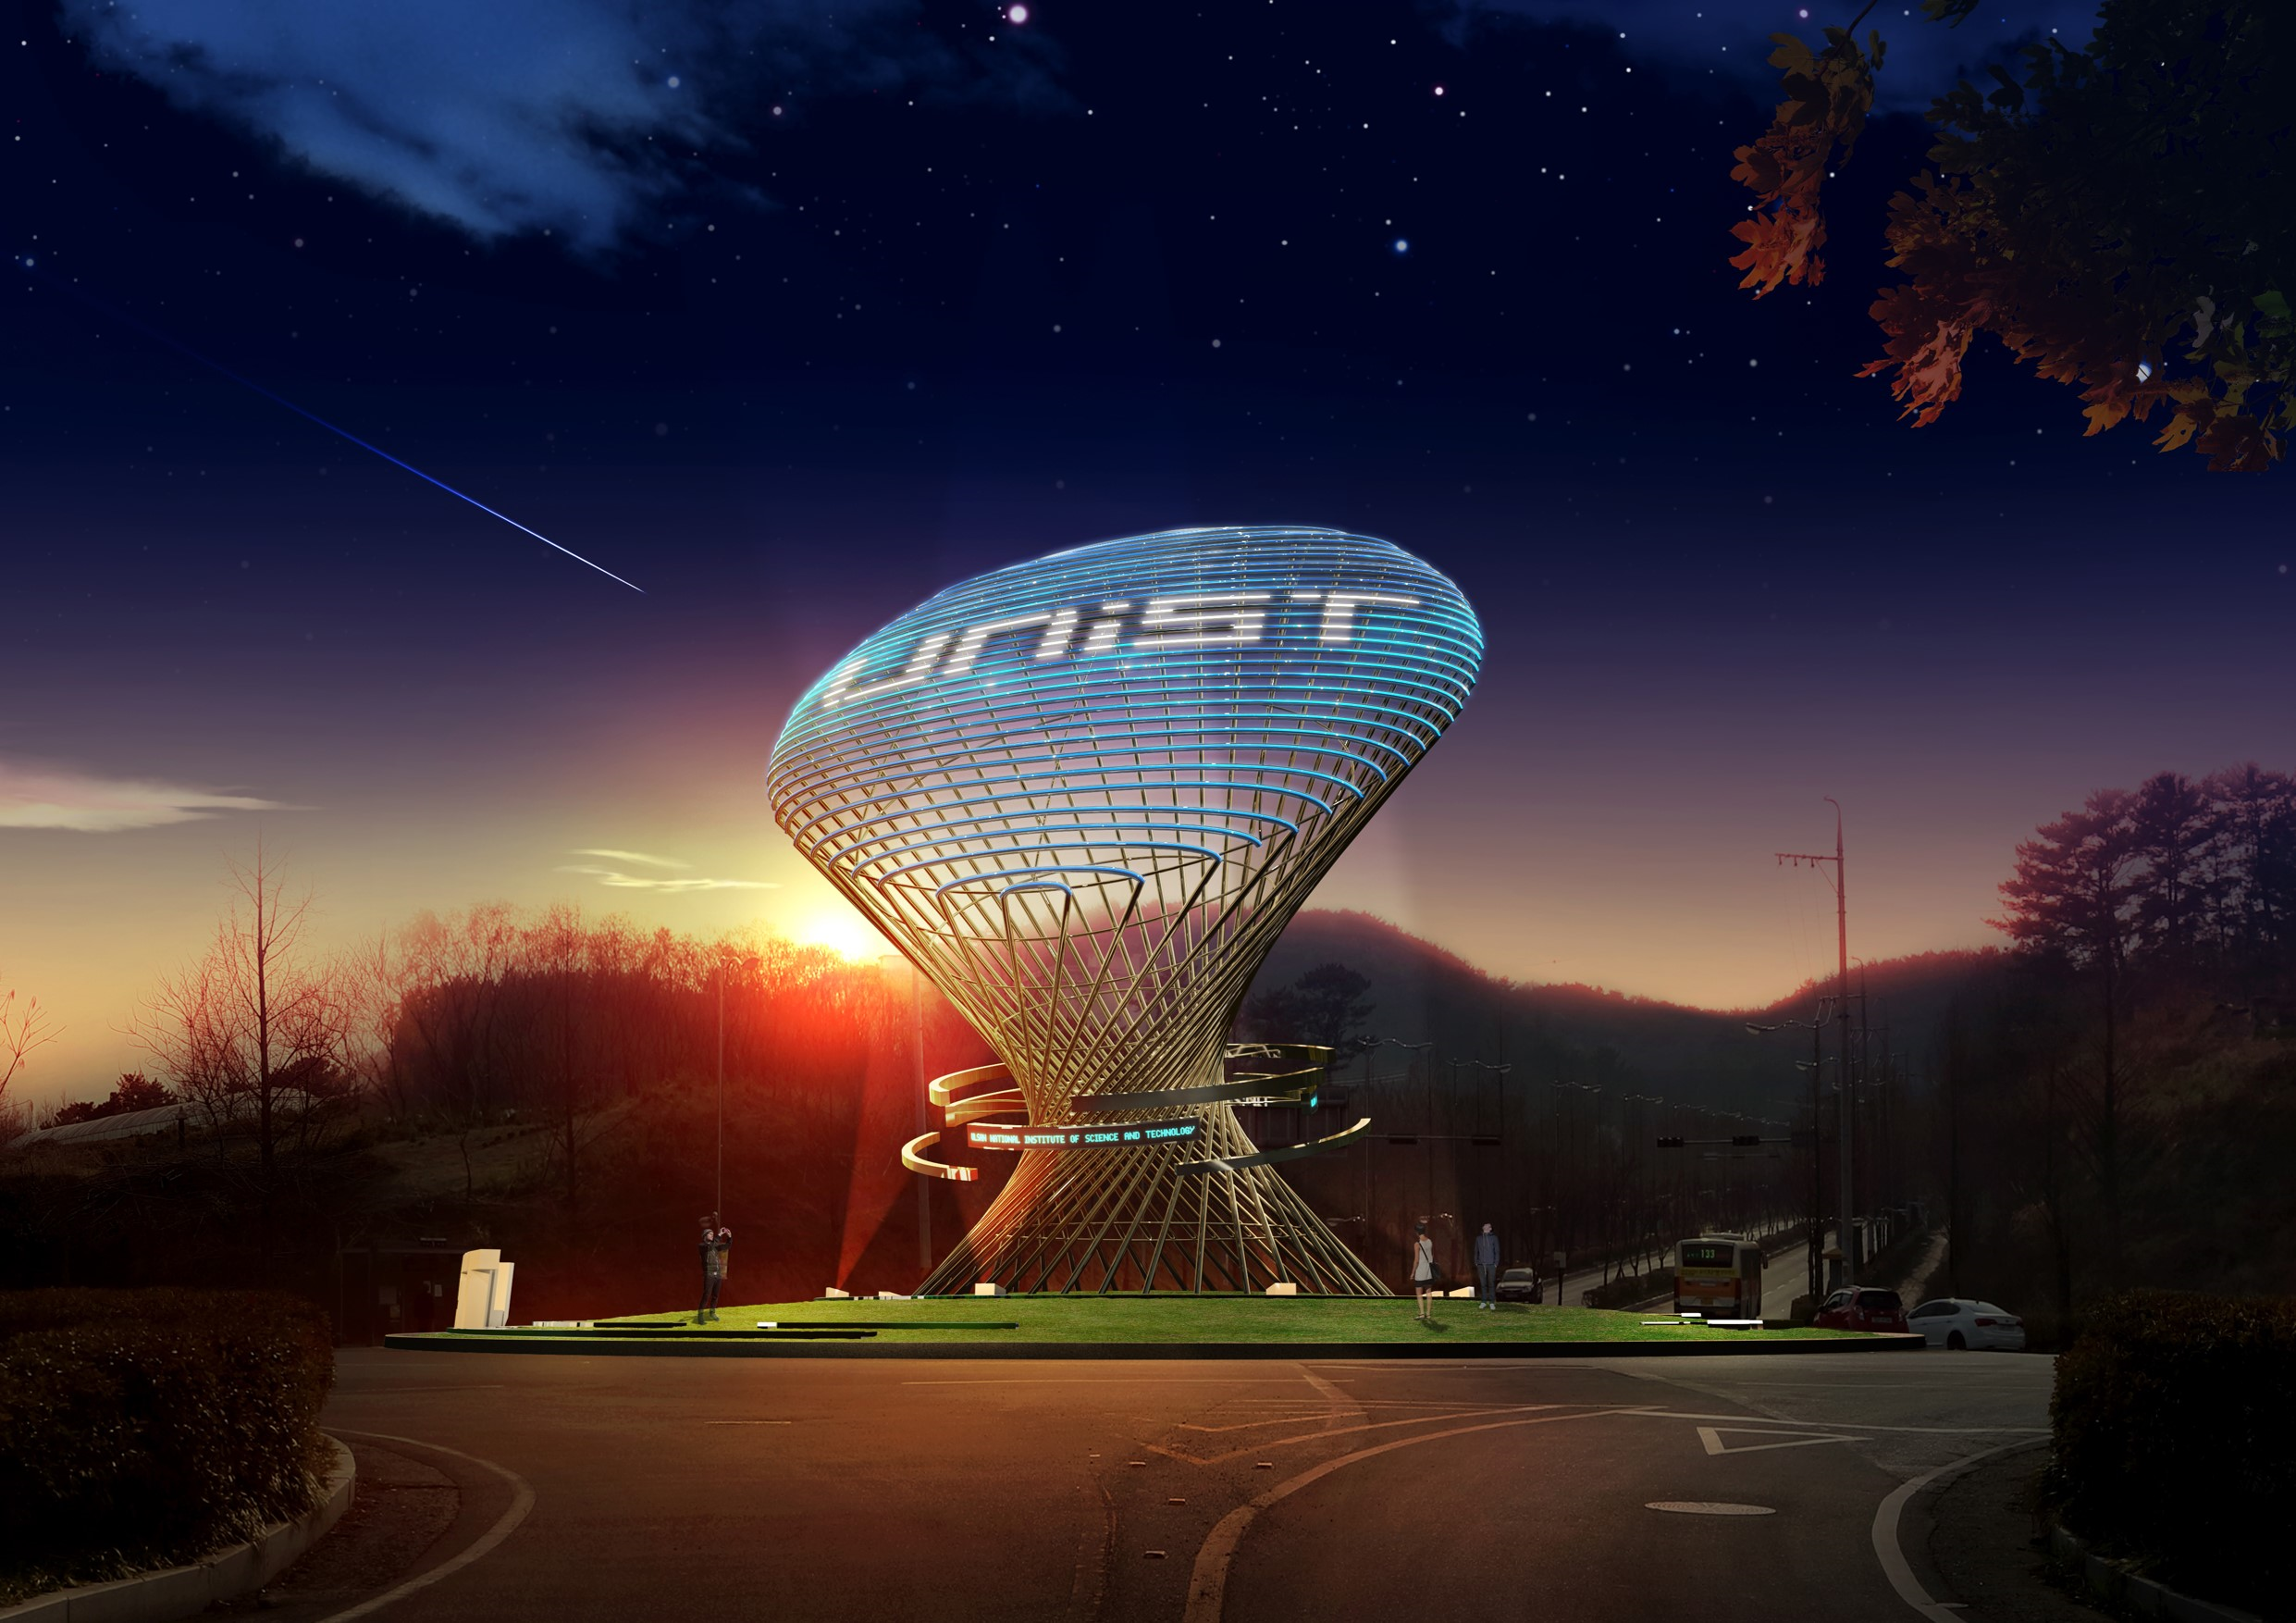





















Current Status
Global Relationship
Nazarbayev
University
University of
S&T of China
Virginia
Technology
University of
Cambridge
University of Michigan
-Ann Arbor
University of
Sabanci
University of
Oklahoma
Harvard
University
University of
Keio
UC Berkeley
International
Relationship
Eindhoven
University of
Technology
University of
North Carolina
UC-Irvine
UAS Wien
HKUST
Florida
State University
The number of Country 55
IIT
-Kanpur
UC San
Diego
The number of Universities 237
Ashesi
University
University of
Sydney
Georgia
Tech

Slide 5
Current Status · Academic Program
UNDERGRADUATE
GRADUATE
Academic
Program
3 Colleges 14 Departments
16 Departments
2 School

Slide 6
Current Status · Overall
Cumulative number of Students
2015
2016
2017
2018
2019
2020
Domestic
4974
5370
5776
6153
6533
6910
International
231
285
321
355
392
444
Cumulative number of Freshman until 2020: 7,303
Gender Ratio(All): Male(4,981, 72.1%) / Female(1,929, 27.9%)
Gender Ratio(International) : Male(299, 76.1%)/Female(94, 23.9%)
May.2020
All
students
Domestic
students
International
students
Current Enrolled
Students Status
2,829
2,659
170

Slide 7
Current Status · International Students
Cumulative number of International Students
Recent 4 years
Admission Competition Rate
Algeria
1
Iran
1
Saudi arabia
1
Applicants
Azerbaijan
3
Kazakhstan
129
Somalia
1
474
Competition
Rate
2020
Acceptance
Bangladesh
4
Kyrgyzstan
70
Spain
1
73
6.5:1
Chana
1
Malaysia
1
Sudan
1
Applicants
505
Competition
Rate
Costa Rica
1
Mauritania
1
Syria
1
2019
Acceptance
49
10.3:1
Dominica Republic
1
Mongolia
32
Tajikistan
13
El Salvador
1
Nepal
2
Turkey
13
Applicants
548
Competition
Rate
Ethiopia
2
New Zealand
1
Turkmenistan
11
2018
Acceptance
57
9.6:1
Germany
1
Pakistan
4
Ukraine
3
Ghana
16
Philippines
1
USA
2
Applicants
741
Competition
Rate
India
2
Republic of Korea
12
Uzbekistan
21
2017
Acceptance
53
13.9:1
Indonesia
7
Rusia
4
Vietnam
23

Slide 8
Current Status · International Students
International Olympiad Medalist
Total Medalist Status 7
Total Medalist Status 6
Total Medalist Status 10
IBO
Gold · 0
Silver · 1
Bronze · 4
Merit · 1
Participation · 1
IChO
Gold · 1
Silver · 0
Bronze · 4
Merit · 0
Participation · 1
IMO
Gold · 0
Silver · 0
Bronze · 2
Merit · 4
Participation · 4
Total Medalist Status 7
Total Medalist Status 4
Total Medalist Status 44
IOI
Gold · 0
Silver · 3
Bronze · 2
Merit · 0
Participation · 2
IPhO
Gold · 0
Silver · 0
Bronze · 2
Merit · 0
Participation · 2
Others
Gold · 5
Silver · 16
Bronze · 21
Merit · 0
Participation · 2
Gold
Silver
Bronze
Merit
Participation
Total
Medalist
6
20
35
5
12

Slide 9
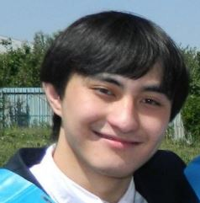
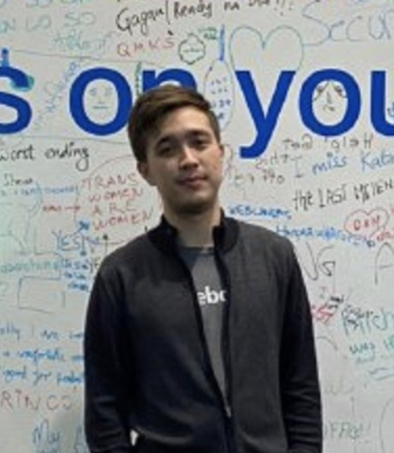
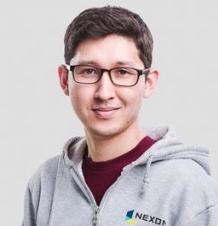
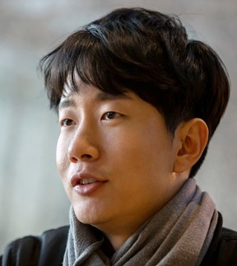
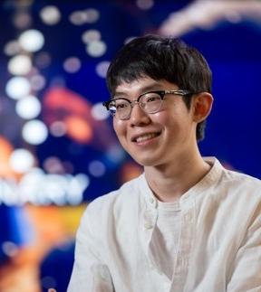
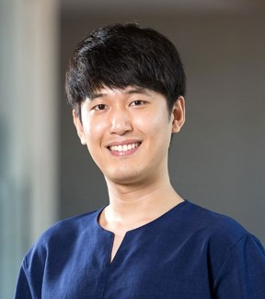
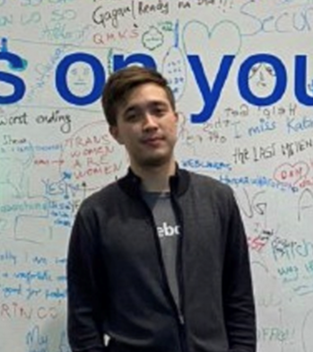
Outstanding Alumni
Computer Science
1
Madi Khamitbekov
1
Republic of Kazakhstan
2
Republic of Kazakhstan
3
Republic of Kazakhstan
Company
Google
1
4
5
6
2
3
Republic of Kazakhstan
Republic of Korea
Republic of Korea
Republic of Korea
Republic of Kazakhstan
Republic of Kazakhstan
Computer Science
2
Zhanadil Nurtoleuov
Company
Facebook
Computer Science
3
Saken Kenzhegulov
Company
Google
Electrical and Computer Eng
4
Republic of Korea
5
Republic of Korea
6
Republic of Korea
4
JunYoung Lee
Company
Lubrik
Electrical and Computer Eng.
5
Taehoon Kim
Company
Open AI
Business Administration
6
Sivaprakash Sengodan
Company
Amazon Japan

Slide 10
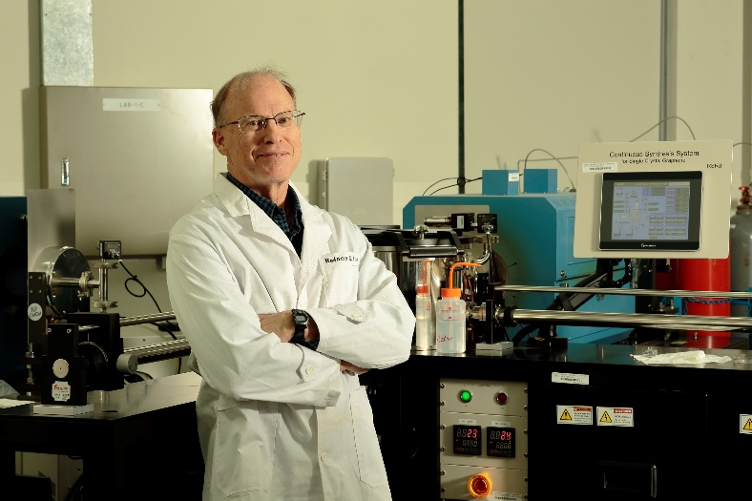
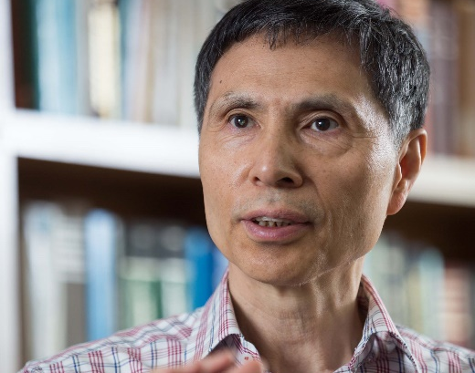
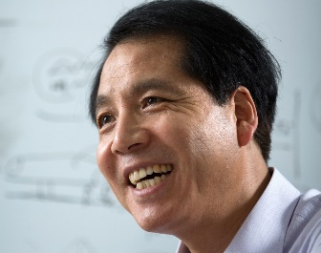
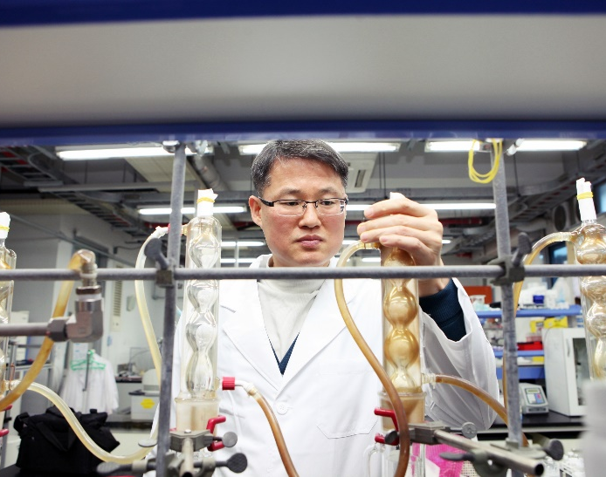
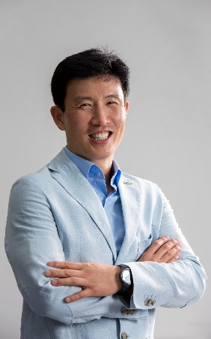

Research Excellence
1
Chemistry
Prof. Rodney S.Ruoff
Natural Science
6 UNIST professors selected as
‘The 2019 Highly Cited Researchers’
2
Chemistry
Prof. Kwangsoo, Kim
Natural Science
1
2
3
3
Cross-Field
Prof. Sangil, Seok
Energy and Chemical Eng.
4
Cross-Field
Prof. Jongbeom, Baek
Energy and Chemical Eng.
4
5
6
5
Meterial Science, Chemistry
Prof. Jaephil, Cho
Energy and Chemical Eng.
6
Battery Science and Technology
Prof. Hyunwook, Lee
Energy and Chemical Eng.

Slide 11
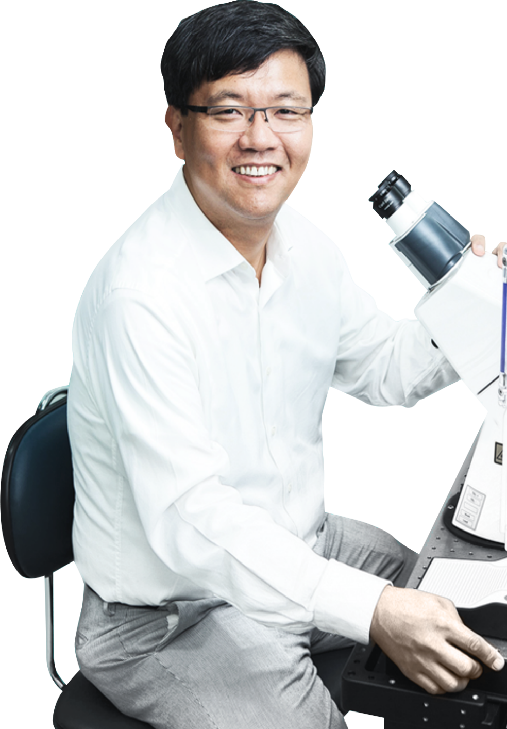


Research Facilities
Director
Kyung Jae Myung
IBS Campus Research Centers
Center for Genomic Integrity
300 Billion KRW for the next 10 years
Research fund
2019
21.1 Billion
2018
20.8 Billion
2017
24.7 Billion
Director
Director
Steve Granick
Rodney S. Ruoff
Center for Soft and
Living Matter
Center for Multidimensional
Carbon Materials

Slide 12

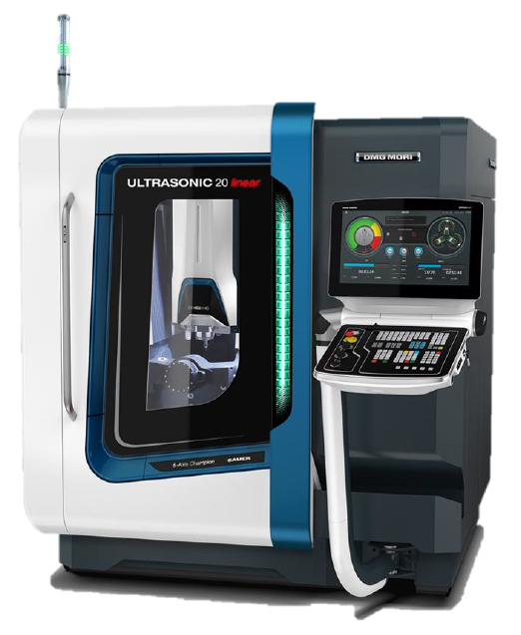
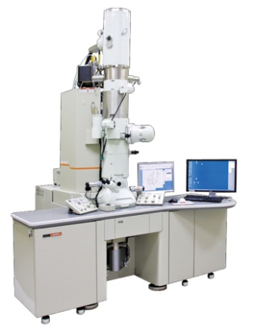
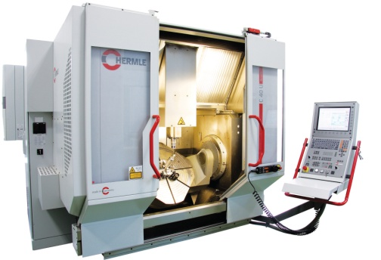
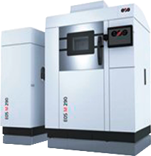
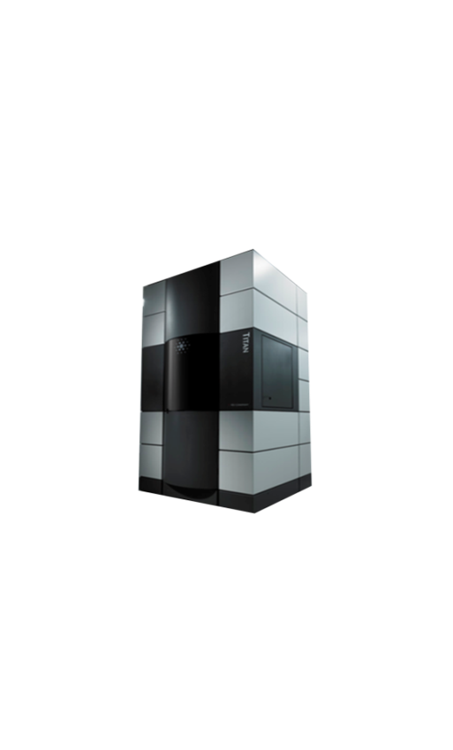
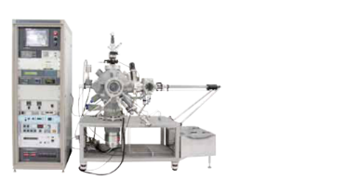

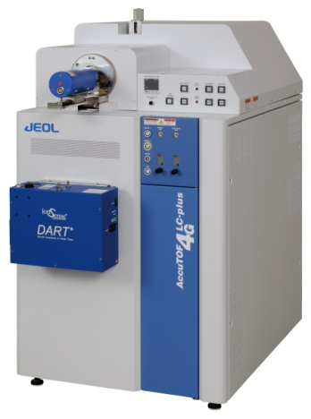
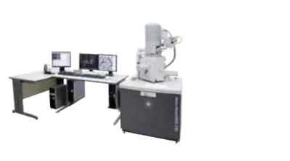
UCRFㅣUNIST Central Research Facilities
Major Research Equipment
9,446 Research Equipment
Invest for 164.6 million
01
05
02
06
Equipment Service for
Institutes & Universities
Annual Income
3.8 million
03
07
04
08
Annual Request
82,899
UNIST Central Research Facilities

Slide 13
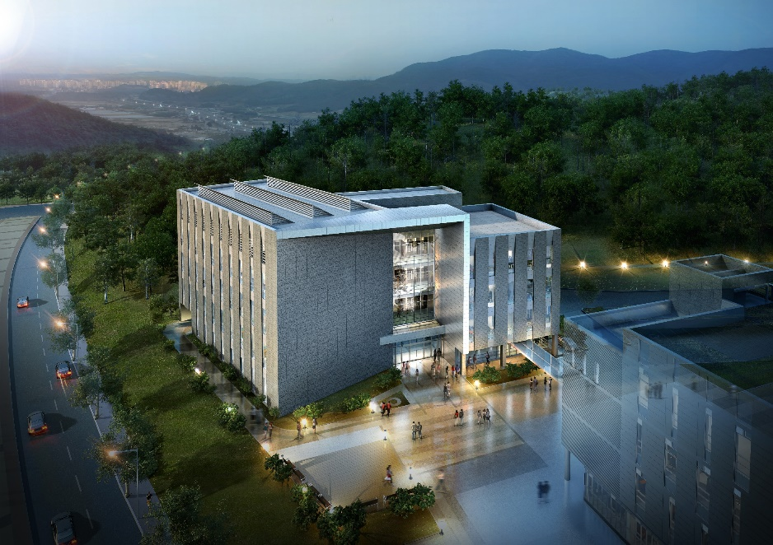


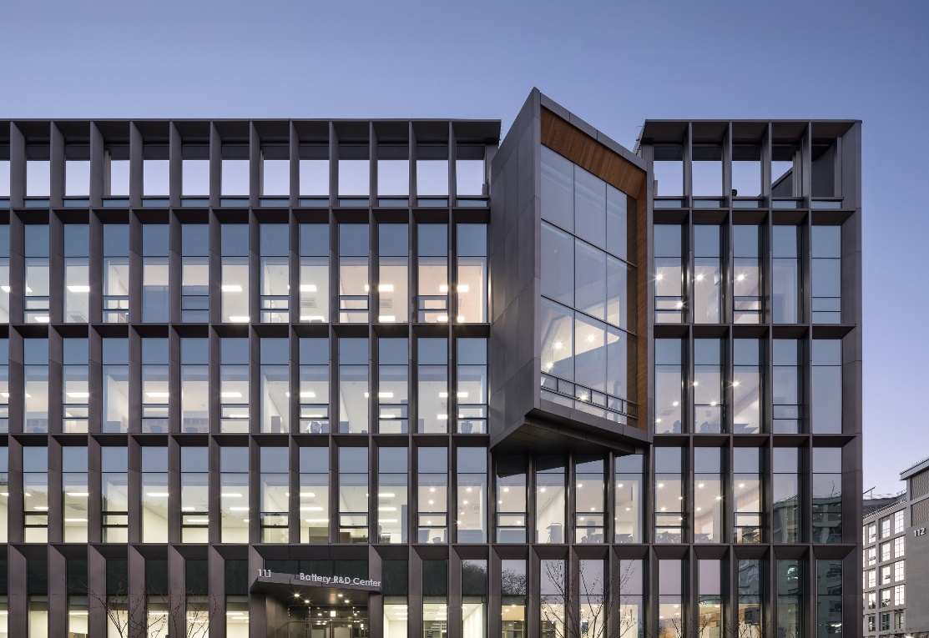

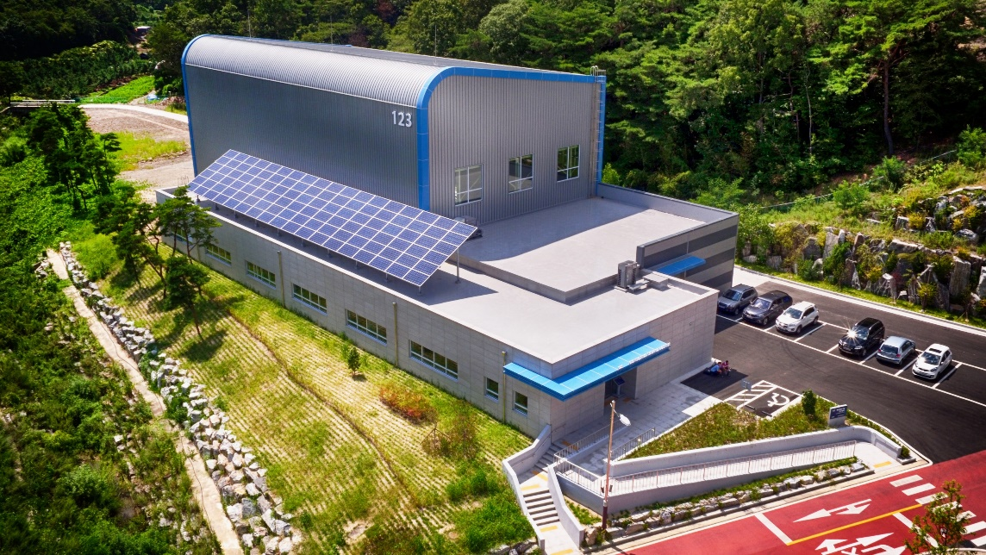
Research Center
Low Demensional Carbon Materials Cetner
Advanced Material Reserch center
Stem Cell Research center
Battery R&D Center
Composites Research Center
Research Center

Slide 14
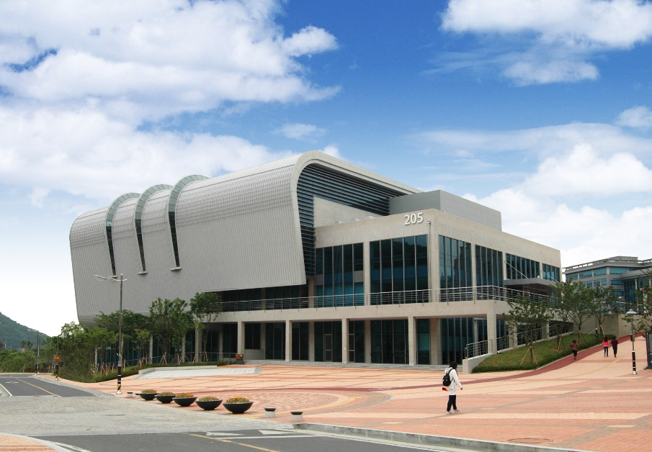
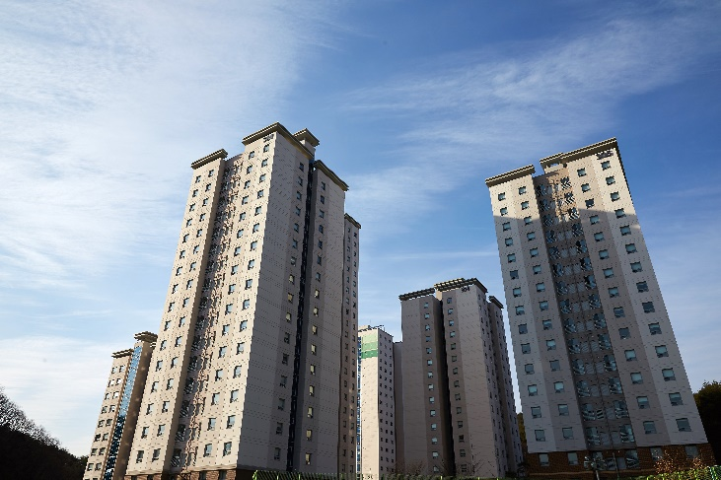

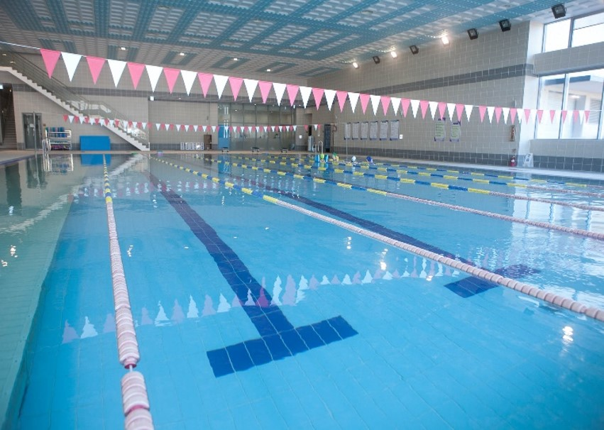
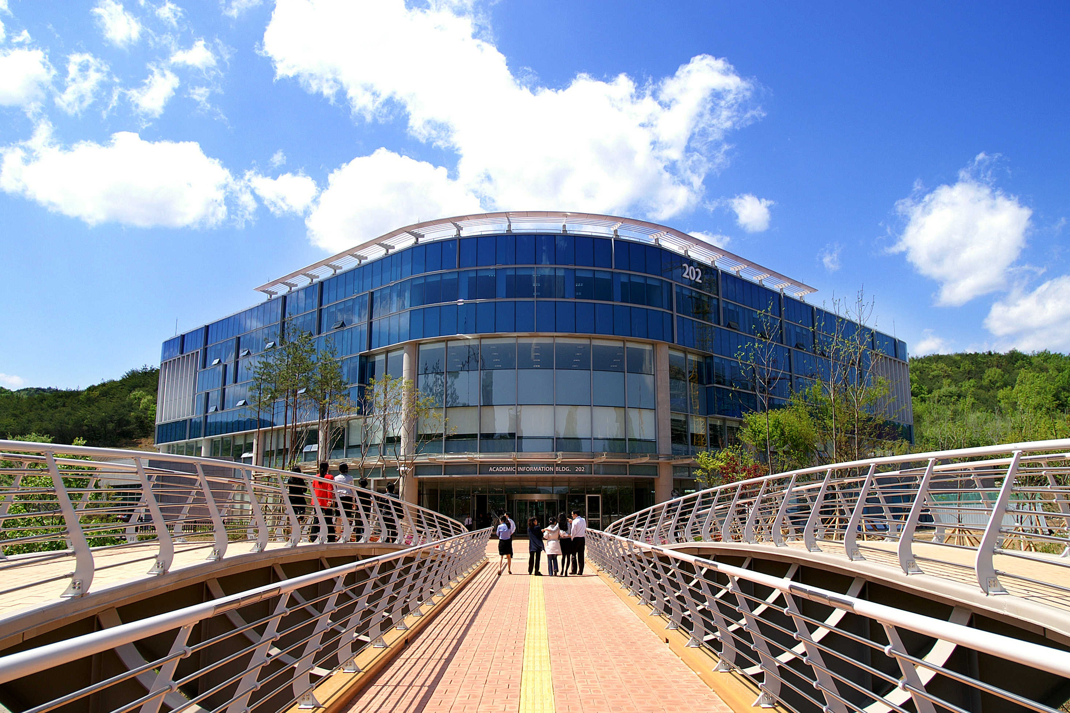
UNIST Facilities
Sports Center
Dormitory
Library
Facilities

Slide 15
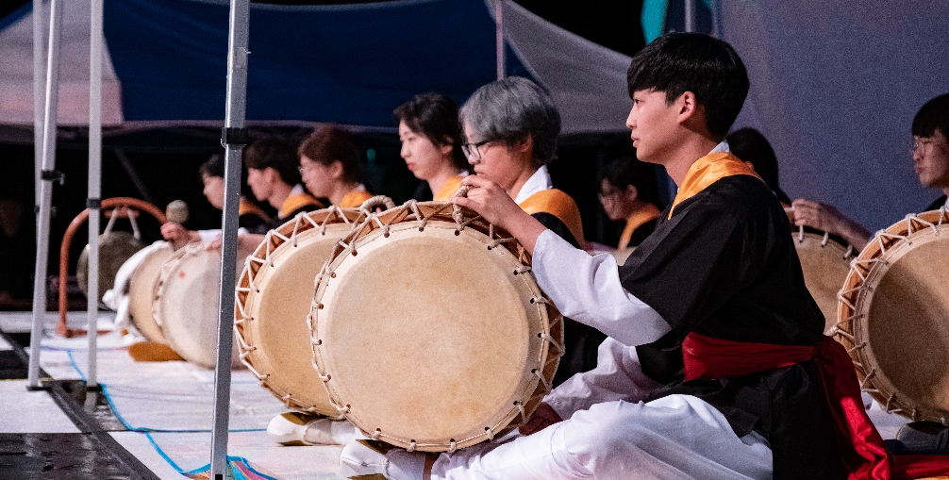
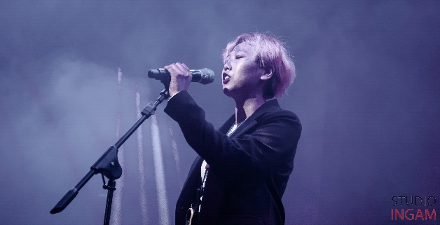
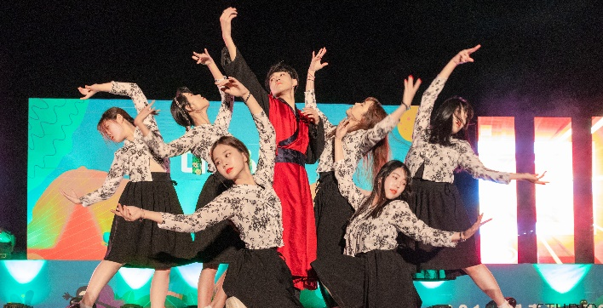
Student Club
Student Club
ASTRAL [Astronomy]
4
Fields
Elite of Elites [Mathematics & Physics]
CZARDAS [Strings ensemble]
JOKER [Magic]
Ensemble [Orchestra]
Crescendo [Band]
U-Turn [Dance]
37
Clubs
E.A United [Football]
MACH [Badminton]
UNIS [Basketball]
UNIST RCY [Voluntary Work]
Etc…

Slide 16
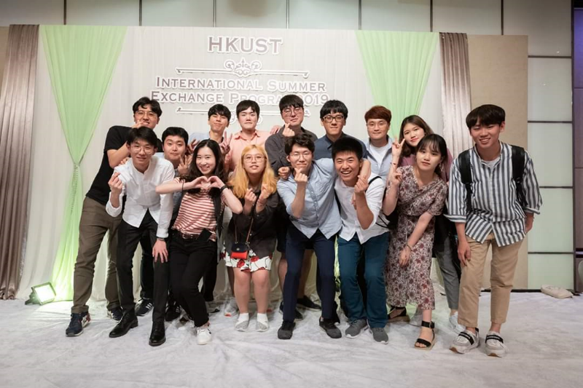
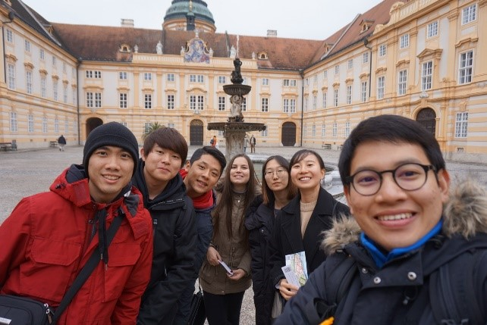
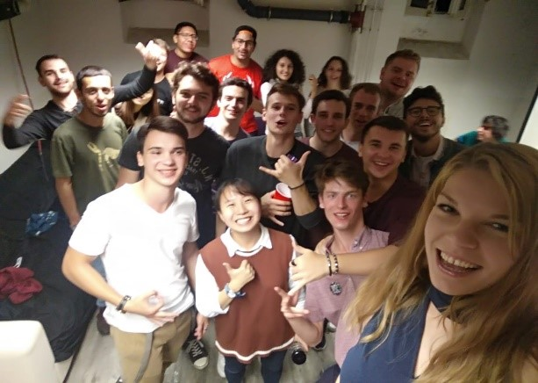

Global Program
Summer Session
Exchange Program
GLOBAL
Country | Institution | Study Period | Requirements
USA | UCLA | 6~10 weeks June to August | iBT 79↑ IELTS 6.5↑
Hong Kong | HKUST (Hong Kong Univ. of Science and Technology) | 8weeks June to August | iBT 80↑ IELTS 6.0↑ TOEIC 800↑
 | Hong Kong Polytechnic Univ. | 6weeks July to August | iBT 80↑ IELTS 6.0↑ TOEIC 800↑
PROGRAM
1
24 University in the world
(Netherlands, Austria, Germany etc)
1~2 semester
3rd to 7th semester is eligible to apply
Minimum 3.1 cumulative GPA
English Requirement: Usually TOEFL IBT 80 ↑
2
3
4
5

Slide 17
Academic Programs
ENGINEERING
College of
Engineering
College of Information-Bio
Convergence Engineering
College of
Natural Sciences
Department of Mechanical Engineering
Department of Urban And Environmental
Engineering
Department of Materials Science &
Engineering
School of Energy and Chemical Engineering
Department of Nuclear Engineering
Department of Design
Department of Biomedical Engineering
Department of Industrial Engineering
Department of Biological Sciences
Department of Electrical Engineering
Department of Computer Science &
Engineering
Department of Physics
Department of Mathematical Sciences
Department of Chemistry
BUSINESS
School of Business Administration
Students are free to choose their majors at the end of freshman year

Slide 18
Scholarship
Amount of benefit for 4 years
 | GOLD |  | SILVER
 | KRW | USD | KRW | USD
Business | 56,880,000 | 46,738 | 42,480,000 | 34,906
Engineering | 60,832,000 | 49,985 | 46,432,000 | 38,153
GLOBAL
UNI-STAR
TUITION FEE
Waiver of Full or Half tuition fee under condition
STIPEND
Scholarship
Gold KRW 630,000
Silver KRW 330,000
Meal Plan
2 meals a day

Slide 19
Scholarship
Amount of benefit for 4 years
 | KRW | USD
Business | 32,880,000 | 27,017
Engineering | 36,832,000 | 30,265
GLOBAL
DREAM
TUITION FEE
Waiver of Full or Half tuition fee under condition
STIPEND
Scholarship
(General Scholarship)
KRW 130,000
Meal Plan
2 meals a day

Slide 20
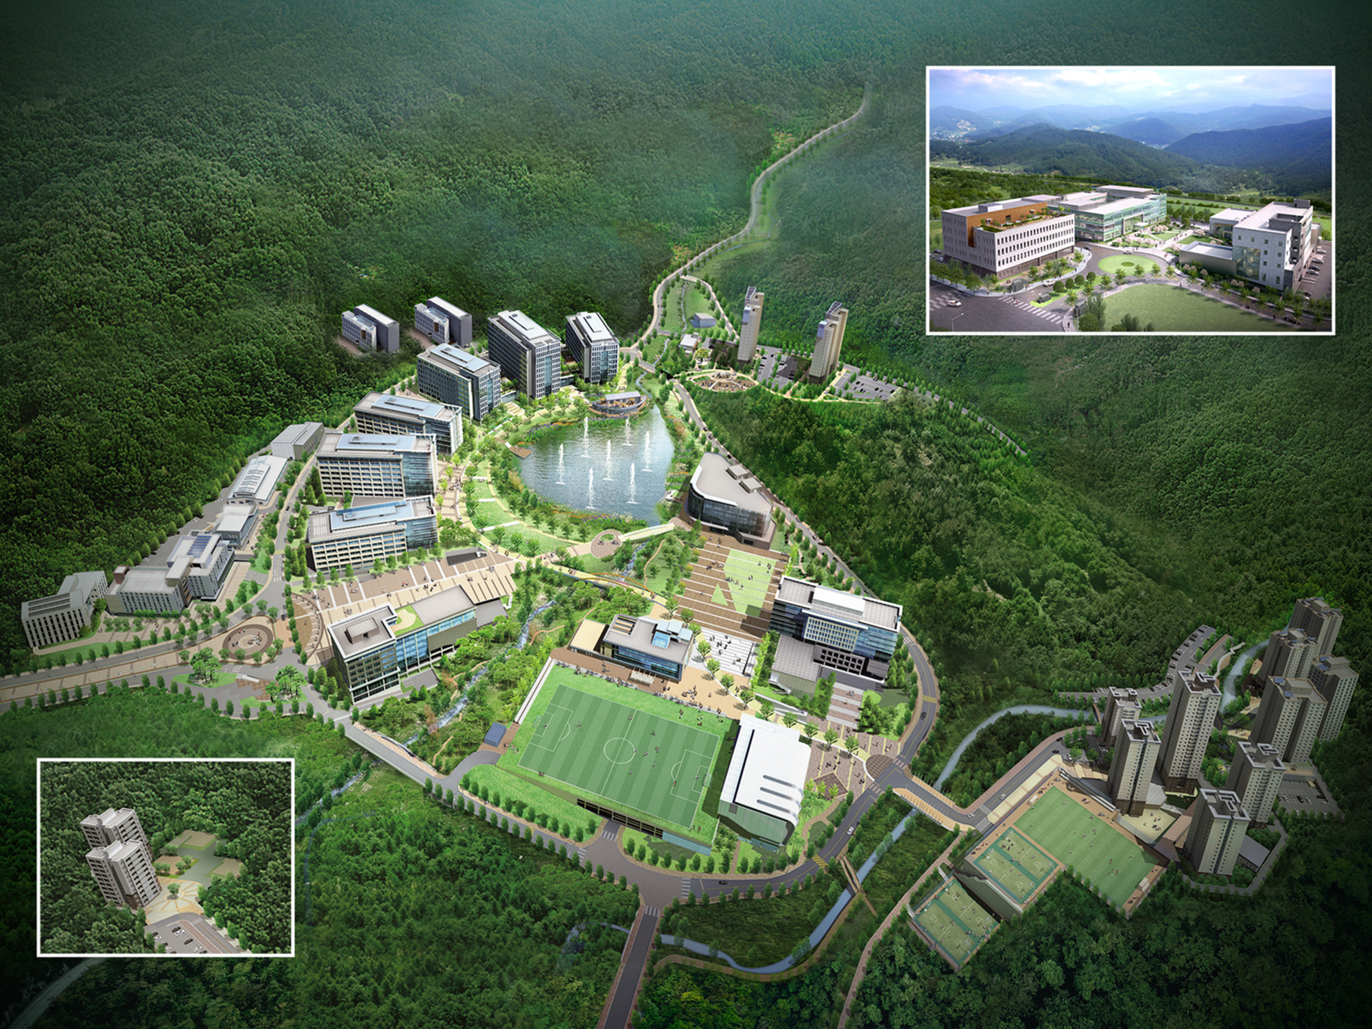
Industry-University Convergence Campus
111
403-404
R&D Center
110
UNIST
CAMPUS
MAP
Engineering Bldg. 4
Research Residence
112
Engineering Bldg. 5
108
207
Nature Science Bldg.
Daycare Center
106
206
109
engineering bldg.3
204
Cafeteria
Special Tests Bldg.
Community Center
107
104
Machine Manufacturing Bldg.
engineering bldg.2
202
105
102
Libray
Stem Cell Research Bldg.
engineering bldg.1
301-309
Student Dormitory
114
103
Business Administration Bldg
Advanced Material Research Bldg
101
203
Low Dimensional Carbon
Materials Center
201
Students Union Bldg.
Main Administration Bldg.
401-402
205
Faculty Apartmet
Gymnasium

Slide 21
Fall Undergraduate
Admission Guideline

Slide 22
2020 Fall Undergraduate Admission Result
Applicants
Registration
Competition Rate
Engineering
Engineering
Engineering
351
43
5.9:1
Business
Business
Business
94
8
8.5:1
Total
445
Total
51
Total
6.3:1

Slide 23

Admission Process
Admission Schedule
On-line application
Admission Quota
2021.1.12.(Tue.) 10:00 ~ 2.18.(Thu.)
http://studyinkorea.go.kr Based on Korean standard time
Submission of Documnents
About
80 Students
2021.1.12.(Tue.) 10:00 ~ 2.18.(Thu.)
Online, Offline Submission
Evaluation & Interview
[Application fee Waiver]
2021.3.15.(Mon.) ~ 4.1.(Thu.)
Telephone interview may be needed.
Announcement
Consideration
By 2021.4.20.(Tue.)
http://adm-u.intl.unist.ac.kr
academic ability,
personal statements,
study plan, vision etc
Registration
2021.4.21.(Wed.) ~ 5.6.(Thu.)
Expected Admission Date
Admission in Fall in 2021

Slide 24
Online Application
Online application Website
Log-in
Online Application
₀₁
http://studyinkorea.go.kr
Sign up as a member
(http://studyinkorea.go.kr)
₀₁
₀₁
Online application → Select “UNIST”
₀₂
Exemption from application fee
₀₂
Log-in
₀₂
Enter the all your information

Slide 25
Online Application
Log-in
Online application Website
Online Application
Attachment
Sign up as a member
(http://studyinkorea.go.kr)
₀₁
₀₁
₀₁
Online application → Select “UNIST”
₀₁
All documents should be attached by deadline(2021.2.11.(Thu.))
http://studyinkorea.go.kr
₀₂
All documents should be submitted in English. Any document in other
language should be accompanied with a notarized English translation.
₀₂
Exemption from application fee
₀₂
Log-in
₀₂
Enter the all your information
₀₃
Please fill out form 1(Checklist) and attach to your application page.
₀₄
Please attach your documents according to the categories.

Slide 26
Online Application
Online Application
Online application Website
Log-in
Attachment
Complete
Sign up as a member
(http://studyinkorea.go.kr)
₀₁
₀₁
₀₁
Applicants can not modify their application after submission
has been completed.
₀₁
http://studyinkorea.go.kr
₀₁
Online application → Select “UNIST”
All documents should be attached by deadline(2021.2.11.(Thu.))
₀₂
All documents should be submitted in English. Any document in other
language should be accompanied with a notarized English translation.
₀₂
Please use temporarily Save button to check your
attachment and application
₀₂
Exemption from application fee
₀₂
Log-in
₀₂
Enter the all your information
₀₃
₀₃
If applicants want to modify their information,
please contact admission staff.
Please fill out form 1(Checklist) and attach to your application page.
₀₄
Please attach your documents according to the categories.

Slide 27
Online Application
Attachment
Log-in
Online Application
Complete
Email reply
Sign up as a member
(http://studyinkorea.go.kr)
₀₁
All documents should be attached by deadline(2021.2.11.(Thu.))
₀₁
Applicants can not modify their application after submission
has been completed.
₀₁
₀₁
Online application → Select “UNIST”
₀₂
All documents should be submitted in English. Any document in other
language should be accompanied with a notarized English translation.
₀₂
Please use temporarily Save button to check your
attachment and application
₀₂
Log-in
₀₂
Enter the all your information
Admission staff will contact you by email
after submission is completed.
₀₃
If applicants want to modify their information,
please contact admission staff.
₀₃
Please fill out form 1(Checklist) and attach to your application page.
₀₄
Please attach your documents according to the categories.

Slide 28
Online Application
Complete
Online Application
Attachment
Email reply
₀₁
Applicants can not modify their application after submission
has been completed.
Online application → Select “UNIST”
₀₁
All documents should be attached by deadline(2021.2.11.(Thu.))
₀₁
₀₂
All documents should be submitted in English. Any document in other
language should be accompanied with a notarized English translation.
₀₂
Please use temporarily Save button to check your
attachment and application
₀₂
Enter the all your information
Admission staff will contact you by email
after submission is completed.
₀₃
Please fill out form 1(Checklist) and attach to your application page.
₀₃
If applicants want to modify their information,
please contact admission staff.
₀₄
Please attach your documents according to the categories.

Slide 29
Online Application
Email reply
Attachment
Complete
₀₁
All documents should be attached within deadline(2021.2.11.(Thu))
₀₁
Applicants can not modify their application after submission
has been completed.
₀₂
All documents should be submitted in English. Any document in another
language should be accompanied by a notarized English translation.
₀₂
Please use temporarily Save button to check your
attachment and application
Admission staff will contact you by email
after submission is completed.
₀₃
Please fill out form 1(Checklist) and attach to your application page.
₀₃
If applicants want to modify their information,
please contact admission staff.
₀₄
Please attach your documents according to the categories.

Slide 30
Compulsory Documents
Categories |  | International Student | Korean | Remarks
1 | Checklist | ○ | ○ | Download http://studyinkorea.go.kr or http://adm-u.intl.unist.ac.kr
2 | Application form | ○ | ○
3 | Academic information | ○ | ○
4 | Personal statement and study plan | ○ | ○
5 | Letter(s) of recommendation signed and sealed | ○ | ○
6 | Financial certification | ○ | ○
7 | Agreement for Verification of academic Record | ○ | ○
8 | Certificate of the entry and exit of the applicant |  | ○ | Original or certified copy
9 | Certificate of enrollment(elementary, middle, high school) |  | ○ | Original or certified copy
10 | Certificate of Transcripts(elementary, middle school) |  | ○ | Original or certified copy
11 | Recent 3 years high (middle) school transcripts (If possible, containing rank or percent for each subject) | ○ | ○ | Certified copy
12 | High school diploma or Certification of the expectant graduation (official letter with Principal's official seal) | ○ | ○ | Certified copy
13 | English test report: TOEFL(Code: 8807), IELTS, TEPS, TOEIC, etc. | ○ | ○ | Original or certified copy
14 | Copy of the applicant's passport | ○ | ○ | Certified copy
15 | Copy of both parents' passports or official documents indicating their nationalities | ○ | ○ | Certified copy
16 | Official document specifying parent-child relationship | ○ | ○ | Original or certified copy
Categories |  | International Student | Korean | Remarks
1 | Checklist | ○ | ○ | Download http://studyinkorea.go.kr or http://adm-u.intl.unist.ac.kr
2 | Application form | ○ | ○
3 | Academic information | ○ | ○
4 | Personal statement and study plan | ○ | ○
Categories |  | International Student | Korean | Remarks
5 | Letter(s) of recommendation signed and sealed | ○ | ○ | Download http://studyinkorea.go.kr or http://adm-u.intl.unist.ac.kr
6 | Financial certification | ○ | ○
7 | Agreement for Verification of academic Record | ○ | ○
8 | Certificate of the entry and exit of the applicant |  | ○ | Original or certified copy
Categories |  | International Student | Korean | Remarks
9 | Certificate of enrollment(elementary, middle, high school) |  | ○ | Original or certified copy
10 | Certificate of Transcripts(elementary, middle school) |  | ○ | Original or certified copy
11 | Recent 3 years high (middle) school transcripts (If possible, containing rank or percent for each subject) | ○ | ○ | Certified copy
12 | High school diploma or Certification of the expectant graduation (official letter with Principal's official seal) | ○ | ○ | Certified copy
Categories |  | International Student | Korean | Remarks
13 | English test report: TOEFL(Code: 8807), IELTS, TEPS, TOEIC, etc. | ○ | ○ | Original or certified copy
14 | Copy of the applicant's passport | ○ | ○ | Certified copy
15 | Copy of both parents' passports or official documents indicating their nationalities | ○ | ○ | Certified copy
16 | Official document specifying parent-child relationship | ○ | ○ | Original or certified copy
All the documents should be submitted in English. Any document in
other language should be accompanied by a notarized English translation.

Slide 31
Supplement Documents
Categories
Remark
Awards while attending high school
Certified copy
High school graduation or University
admission test
Certified copy
Standardized tests and other
academic certifications
Original or certified copy
High school introduction/profile(s)
-
All applicants can submit up to 5 certificates
All documents should be attached to application through online website

Slide 32


Personal Statement
Personal Statement
01
02
03
04
05
01
Please explain how you have overcome financial or social difficulties, physical or emotional
adversities which might have hindered you from studying during middle and high school.
Personal Statement
Personal Statement
Personal Statement
Personal Statement
Personal Statement
“
Please describe any unique characteristics of your school or distinctive qualities of
your secondary education.
“
“
“
“
02
Please explain how you have overcome financial or
social difficulties, physical or emotional adversities which
might have hindered you from studying during
middle and high school.
Please describe any unique characteristics of
your school or distinctive qualities of
your secondary education.
Please describe your special interest and ability
in academic areas during your years
at secondary school(s).
Please explain any of your extracurricular
activities or work experience.
Please explain your purpose in studying at UNIST and
your plans for study. Be as specific as you can regarding
your academic interests and the curriculum
you expect to follow in achieving your goals.
03
Please describe your special interest and ability in academic areas
during your years at secondary school(s).
04
Please explain any of your extracurricular activities or work experience.
05
Please explain how you have overcome financial or social difficulties, physical or emotional
adversities which might have hindered you from studying during middle and high school.

Slide 33


Evaluation
Common criteria
Based on all the submitted documents such as personal statements, transcripts,
and letter(s) of recommendation, UNIST considers various factors comprehensively
including academic ability, personal accomplishments, study plan, vision and
potential when determining admission.
Evaluation will be conducted by two or more evaluators.
Evaluation will takes for 2~3 weeks.
Dossier Evaluation
After the dossier evaluation, all the applicants are decided as
Accepted
Interviewed
Rejected

Slide 34
Evaluation
Common criteria
Based on all the submitted documents such as personal statements, transcripts,
and letter(s) of recommendation, UNIST considers various factors comprehensively
including academic ability, personal accomplishments, study plan, vision and
potential when determining admission.
Evaluation will be conducted by two or more evaluators.
Evaluation will takes for 2~3 weeks.
Interview
1
It will be conducted by Telephone.
Telephone interview will be only directed to the applicants selected as interviewees
Interview will be focused on applicant’s suitability, vision etc.
After the interview, all interviewees are decided as "Accepted", “Candidate” or "Rejected".
2
3
4

Slide 35
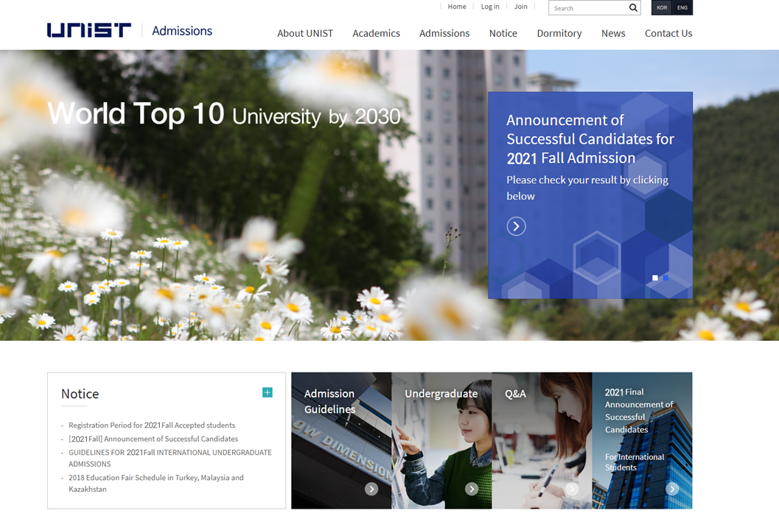
Announcement
Announcements
http://adm-u.intl.
unist.ac.kr/
20th.Apr.2021

Slide 36
Q&A

Slide 37


